Slide 1

AI human detection with Person-specific Recognition for a Robot Cell
Group Number – CV5B
Group Members
Avaneesh Vetrivelan :605454
Charan Prasad Ramaswamy Govinda Prasad :605515
Jashwanth Kalegowda :601780
Mohammed Imaad :605772
Prajwal Babu Reddy :604347
Intelligent Forming Systems
MSc. Johannes Pusicha
Prof. Dr. Johannes Buhl

Slide 2
Aim and Objectives of the Project
Aim
To design and deploy a near real‑time camera-based system on an NVIDIA Jetson Nano that reliably detects and identifies humans in a robot cell, triggers appropriate safety signal, and can be configured for different scenes without retraining.​
Objectives
Goal: Vision-based safety system for robot cells that detects only humans entering a defined safety zone and triggers a robot stop warning.
Robust Detection: Reliably ignores robot, grippers, and workpieces; focuses solely on human presence.
Configurable Deployment: Scene profiles/calibration to adapt to different cells/rooms without retraining the core model.
Performance: Runs on NVIDIA Jetson Nano.

Slide 3
Project Motivation and Problem Statement
Project Motivation
Robotized forming cells → higher safety demands
No human/machine distinction → false stops & downtime
Vision-based, human-focused layer → targets people only, reduces unnecessary stops
Problem Statement
Issue: Safety-rated sensors cannot distinguish humans vs. objects, causing false trips and unnecessary downtime.
Need: Camera-based, human-only detection in robot-cell zones with safety actions.
Robustness: Must work across different cells/rooms, be reconfigurable via calibration/profiles, no full retraining.
Advanced behavior: Recognize specific individuals .
Constraint: Run on limited compute – NVIDIA Jetson Nano

Slide 4
Key Technical Challenges
Real-time on Jetson Nano
Near FPS with deep-learning models on resource‑constrained hardware.
Reliable human‑only detection
Distinguish humans vs. robots/grippers/workpieces in dynamic cells with occlusions and overlapping motion.
Robustness to environment
Handle lighting changes, metal reflections, shadows, and varying camera viewpoints.
Scene adaptation via configuration
Adapt to different cells/rooms, layouts, safety zones through calibration/profiles only – no model retraining.

Slide 5
System Requirements
Functional Requirements:
Detect humans entering a defined robot‑cell area
Ignore non‑human motion (robot arm, grippers, workpieces)
Generate a signal when a human is inside safety zone and save it in EXCEL sheet
Non‑Functional Requirements:
Run on NVIDIA Jetson Nano (≥ X FPS)
Provide robust detection under moderate occlusions
Scene setup / calibration must be doable by an operator (no deep AI expertise)

Slide 6
High Level System Architecture
1.Sensing Layer (Camera)
Raspberry Pi Camera mounted to view the robot cell
Continuously captures video frames (e.g., 720p/1080p) and streams to Jetson Nano
2.Edge AI Layer (Jetson Nano – Vision Processing)
Frame acquisition: Python + OpenCV read camera frames
Human detection: Roboflow / YOLO model outputs person bounding boxes
Zone checking: Compares detections with predefined safety zone(s)
3.Configuration
Configure files / simple UI store: camera pose, ROI, safety‑zone coordinates, thresholds, performance settings
4.Control & Interface Layer (Robot / Safety System)
Unauthorized human inside safety zone → send STOP signal to robot/safety logic
No human in zone → maintain RUN / normal operation signal

Slide 7
Hardware Components
1.NVIDIA Jetson Nano
Edge AI compute platform
Runs human‑detection model and decision logic in near real time
Processes camera frames and sends warning/stop signals
2.Raspberry Pi Camera (MIPI CSI)
Continuous video capture of robot cell
Feeds image stream to Jetson for detection
3.Tripod / Camera Mount
Fixed, stable camera position
Correct viewing angle and coverage of safety zone
Enables repeatable calibration
4.Power Source and Peripherals
Reliable power for Jetson.
Keyboard and Monitor as peripherals

Slide 8
Software Components
1.Operating System on Jetson Nano (Jet Pack / Ubuntu)
Base runtime environment
Provides GPU drivers, camera access, and runs Python, OpenCV, detection pipeline.
2.Python
Orchestrates frame capture, model inference, decision logic
Manages communication with robot interface / simulation
3.OpenCV
Handles video capture from Raspberry Pi camera
Performs image pre‑processing (resize, color convert) and visualization (boxes, overlays)
4.Roboflow‑based Human Detection Model
Deployed YOLO‑style human detector exported from Roboflow
Takes frames as input, outputs bounding boxes + confidence for humans
5.Decision Logic / State Machine
Interprets detections vs. safety zone
Sends outputs signals to Excel Log File

Slide 9
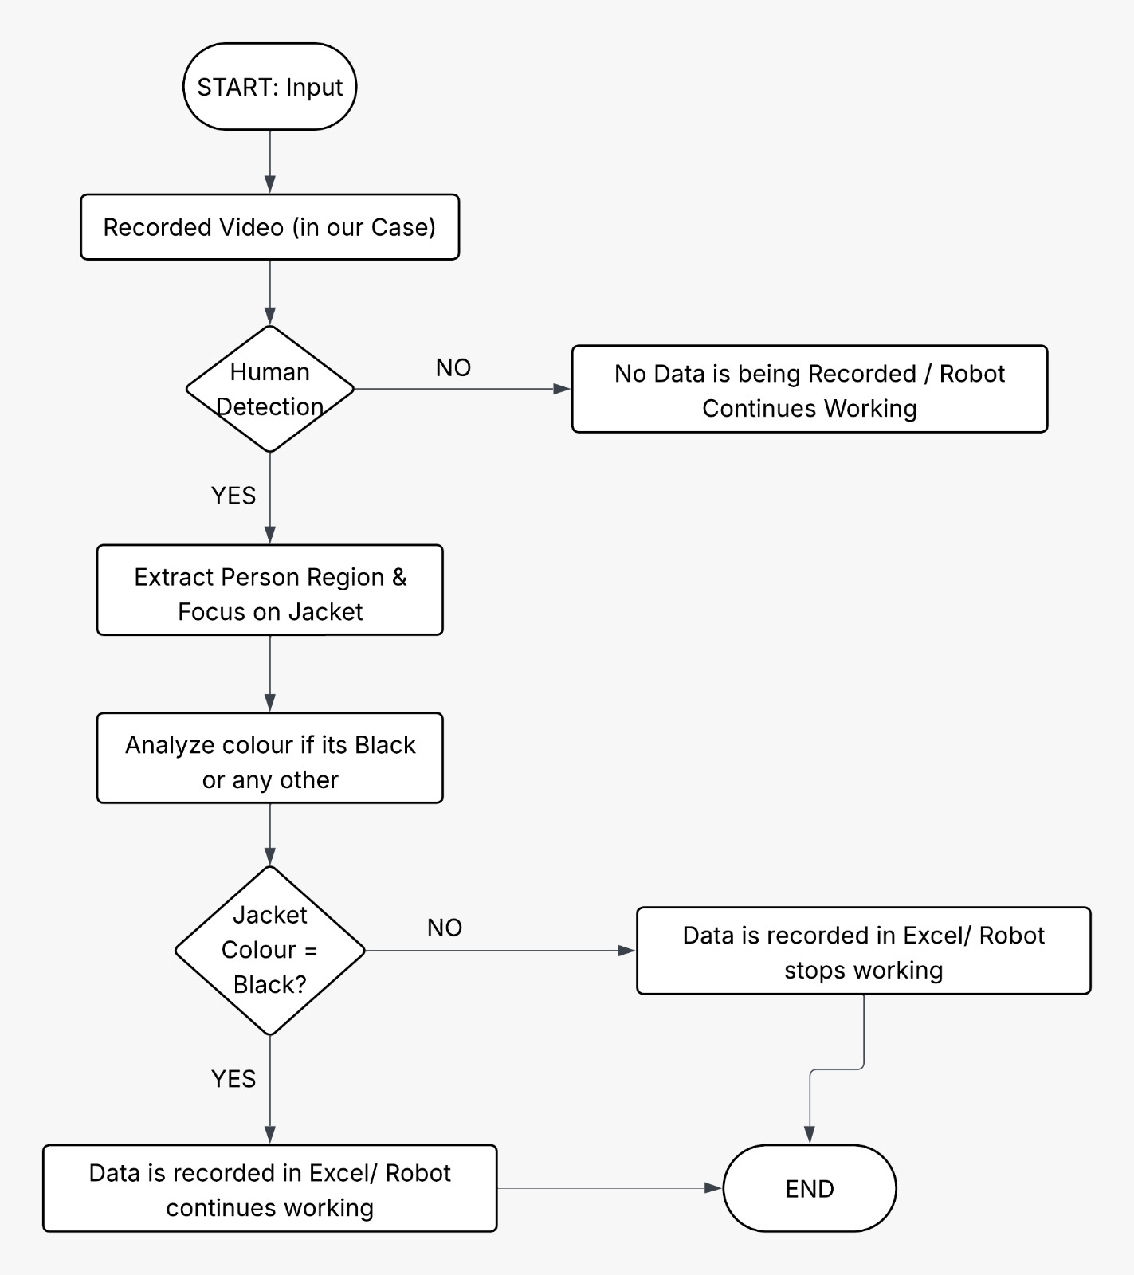
Process Flowchart

Slide 10
System Logic Run
1. Frame Input
Read image/video frame.
2. Human Detection
Run human detection model.
IF no human detected → Robot continues working.
IF human detected → Go to jacket colour detection.
3. Extract Person Region
Crop bounding box of detected human.
Focus on jacket (where jacket colour is visible).
4. Jacket Colour Detection
Analyze dominant colour of detected jacket area.
Convert image to RGB colour space.
Check if colour falls in black colour range.
5. Decision Logic
IF Jacket colour = Black →Access = TRUE
Robot = Continue operation
ELSE (Any other colour) →Access = FALSE
Robot = STOP immediately
Generate warning signal / message.
6. Safety Priority Rule
If detection confidence is low → Treat as No Access → Stop robot (fail-safe design)

Slide 11
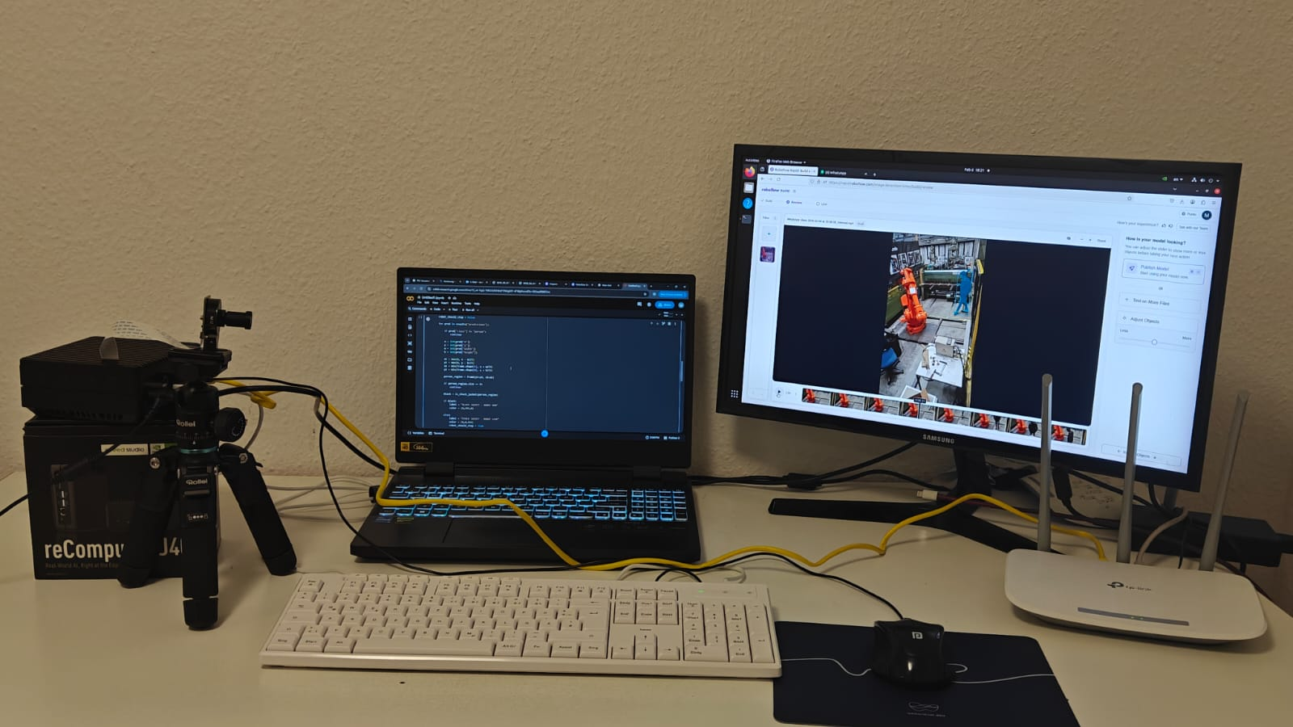
Experimental Setup
Figure 1 : Experimental Setup for the Project

Slide 12
Connections Explained
1.Raspberry Pi Camera → Jetson Nano (CSI)
CSI connection for live video stream used in vision/AI processing
2.Keyboard & Mouse → Jetson Nano (USB)
Direct control of Jetson: terminal, code execution, debugging
3.Monitor → Jetson Nano (HDMI)
Displays desktop, camera feed, and program output
4.Jetson Nano → Router (Ethernet)
Provides network, SSH, file transfer, device communication
Programming done via Jetson Nano terminal

Slide 13
Program Description
Step 1 – Initialize
Start program, prepare Excel log, load person‑detection AI model
Step 2 – Open Video
Load pre‑recorded factory video, read frame by frame
Step 3 – Person Detection
For each frame, AI checks for person presence
No person → robot keeps running
Step 4 – Jacket Color Check
If person found, inspect body region and detect jacket color

Slide 14
Step 5 – Safety Decision
Black jacket → authorized → Robot RUN
Non‑black jacket → unauthorized → Robot STOP
Step 6 – Log Violations
For each unauthorized person: store timestamp and “Robot Stop” in Excel
Step 7 – Visual Feedback
Draw bounding box and show “Robot Running / Robot Stop” on video
Step 8 – Close & Save
Save Excel safety log, release video, end program

Slide 15
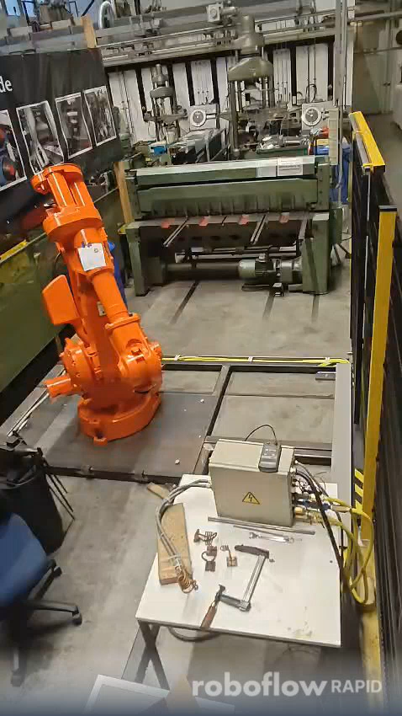
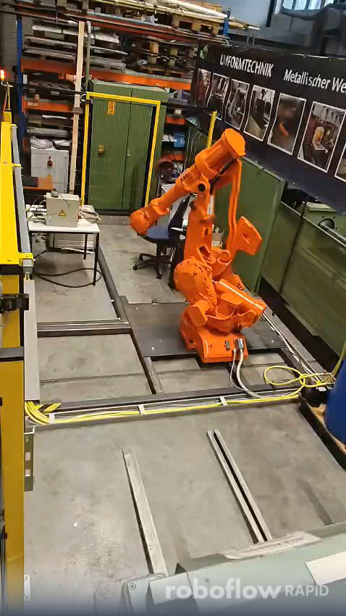
Results Obtained
Video 1 : AI Human Detection in a Robot cell with Person 1( wearing a Black Jacket)
Video 2 : AI Human Detection in a Robot Cell with Person 2(without wearing a Black Jacket)

Slide 16
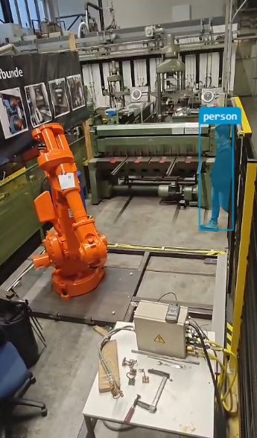
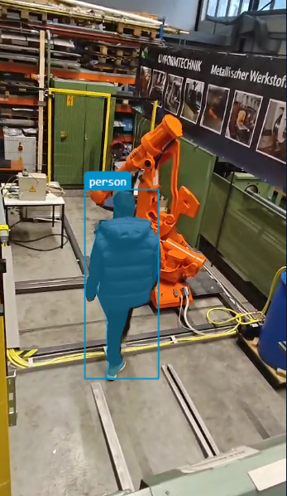
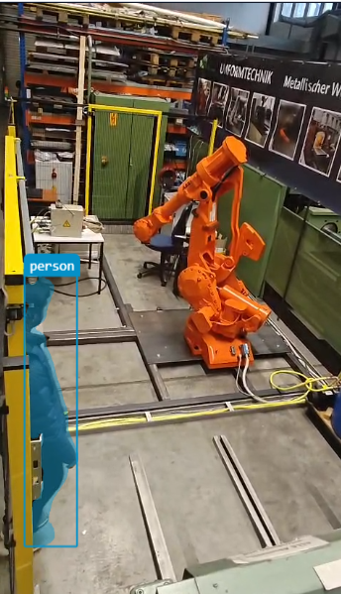
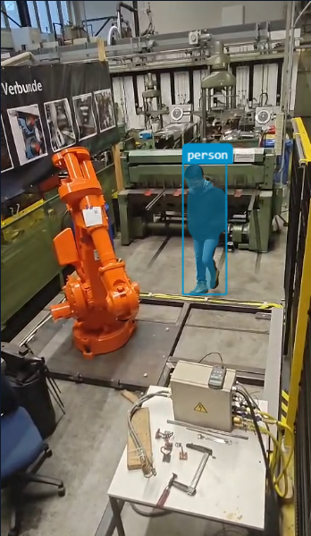
Images Captured
Figures 2,3,4,5 : AI Detection of Human in a Robot Cell

Slide 17
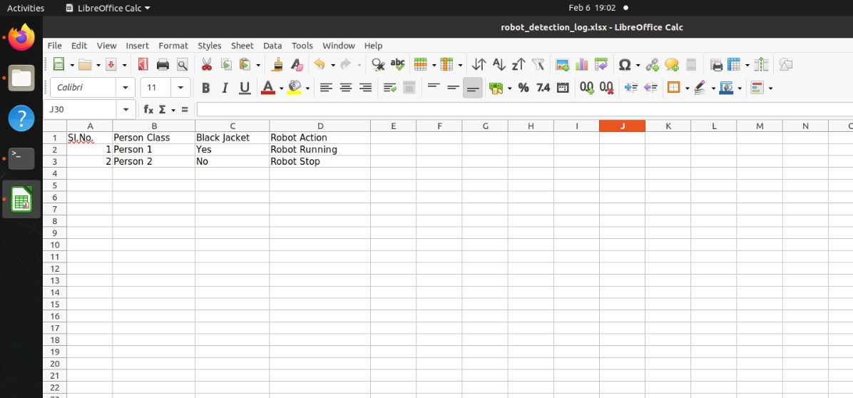
Program Output
Figure 6 : Python Program Output ( Excel sheet )

Slide 18
Limitations
Person identification is limited to jacket color, which can be affected by lighting conditions, shadows, or similar colors.
Face recognition and identity differentiation are limited to a small number of known individuals.
Performance may degrade under poor lighting, heavy occlusion, or reflective industrial surfaces.
Real-time performance is constrained by the hardware limitations of the Jetson Nano.
The system has been tested mainly on pre-recorded or controlled scenarios, not continuous industrial operation.

Slide 19
Future work
Integrate deep-learning–based face recognition instead of color-based identification for higher reliability.
Add multi-camera support to cover blind spots and large robot cells.
Improve robustness against lighting variations using adaptive preprocessing or HDR cameras.
Implement dynamic safety zones that adapt to robot motion and task context.
Perform long-term testing in real industrial environments.

Slide 20
Conclusion
Jetson‑based AI safety system deployed on NVIDIA Jetson Nano for camera‑based human detection in a robot cell
Reliable human‑only detection while ignoring robots, grippers, workpieces
Person‑specific logic via jacket color to separate authorized vs. unauthorized persons
Fail‑safe safety logic: robot stops when detection confidence is low
Scene adaptability through configuration & calibration, no model retraining
Near real‑time performance achieved on limited compute
Demonstrates vision‑based human detection as a flexible, intelligent safety layer for industrial robot cells

Slide 21
References
NVIDIA Accelerated GStreamer: NVIDIA, "Accelerated GStreamer," in NVIDIA Jetson Linux Developer Guide, Rel. 35.5.0, June 2024. [Online]. Available: https://docs.nvidia.com/jetson/archives/r35.5.0/DeveloperGuide/SD/Multimedia/AcceleratedGstreamer.html
Utility: NVIDIA, "Taking Your First Picture with CSI or USB Camera," in NVIDIA Developer Tutorials, [n.d.]. [Online]. Available: https://developer.nvidia.com/embedded/learn/tutorials/first-picture-csi-usb-camera
Camera Software Architecture: NVIDIA, "Camera Development," in NVIDIA Jetson Linux Developer Guide, Sept. 2024. [Online]. Available: https://docs.nvidia.com/jetson/archives/r35.4.1/DeveloperGuide/text/SD/CameraDevelopment.html
DashCamNet Model: NVIDIA, "DashCamNet Model Card," in NGC Catalog, Aug. 2024. [Online]. Available: https://catalog.ngc.nvidia.com/orgs/nvidia/teams/tao/models/dashcamnet
Multi-Camera AI Pipelines: NVIDIA, "Implementing Real-Time,Multi-Camera Pipelines with NVIDIA Jetson," NVIDIA Technical Blog, Apr. 2022. [Online]. Available: https://developer.nvidia.com/blog/implementing-real-time-multi-camera-pipelines-with-nvidia-jetson/
Example GStreamer Pipelines: RidgeRun, "Jetson Nano GStreamer example pipelines," RidgeRun Developer Wiki, Nov. 2024. [Online]. Available: https://developer.ridgerun.com/wiki/index.php/Jetson_Nano/GStreamer/Example_Pipelines

Slide 22
References

